Slide 1
Physical Geography of Latin America

Slide 2
-Latin America covers 7,000 miles
-From the border of the U.S. and Mexico to Tierra del Fuego
-Also includes the Caribbean Islands

Slide 3
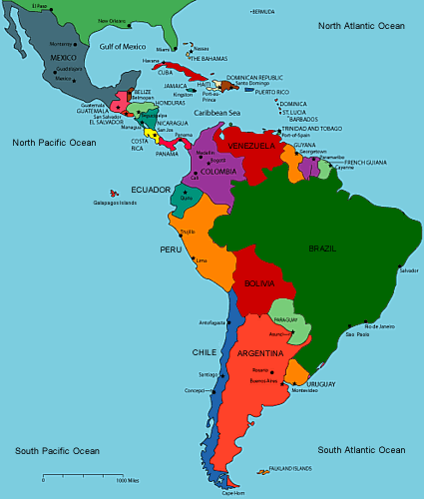

Slide 4
-Andes Mountains: part of mountain chain that includes the Rocky Mountains and the Sierra Madres
-Barrier for movement into the interior of South America
-More settlement has occurred along eastern and northern coasts

Slide 5
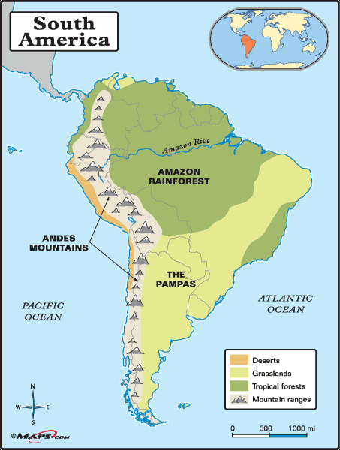

Slide 6
-Llanos: grassy, treeless areas used for farming and livestock grazing found in Colombia and Venezuela
-Cerrado: flat plains found in the interior of Brazil
-Moderate rainfall makes it suitable for farming
-Pampas: grasslands with rich soil located in Northern Argentina and Uruguay
-Main products are cattle and wheat grain

Slide 7
River Systems
-Orinoco River: flows more than 1,500 miles, partly along the Colombia/Venezuela border
-Amazon River: flows about 4,000 miles from west to east, empties into Atlantic Ocean
-Flows across Brazil
-Has over 1,000 tributaries

Slide 8
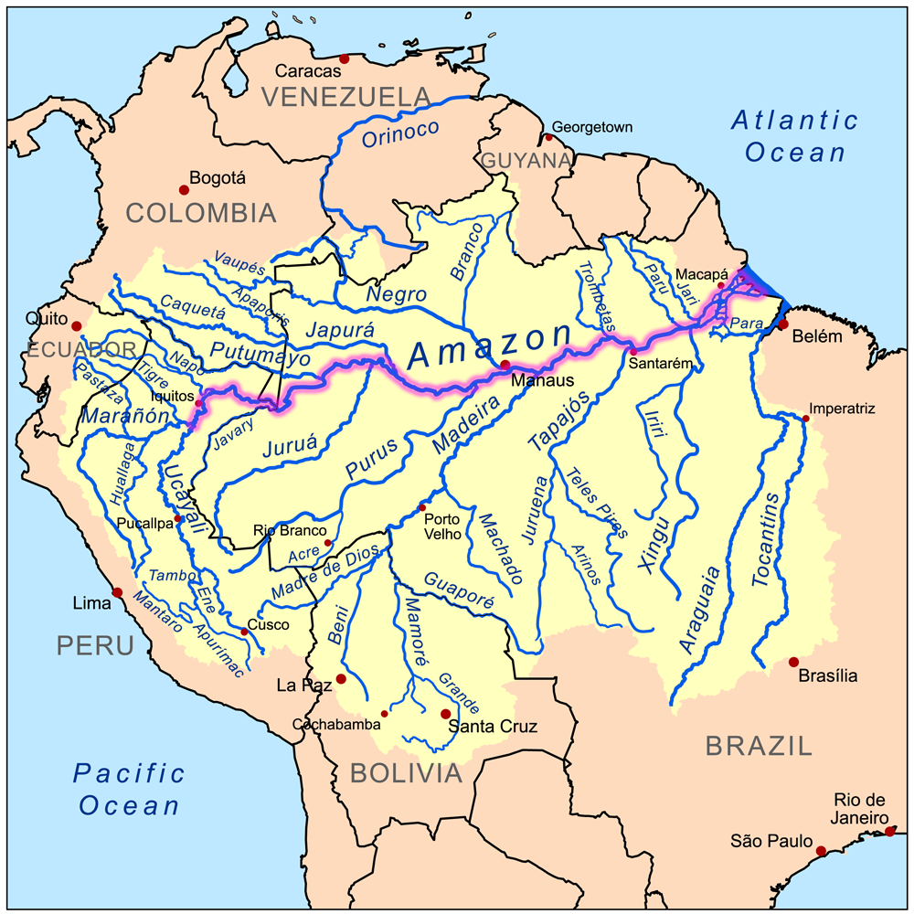

Slide 9
Natural Resources
-Mineral resources: gold, silver, iron, and copper
-Many minerals are mined in Latin America and shipped to other areas of the world for production

Slide 10
Natural Resources
-Energy resources: oil, coal, natural gas, and hydroelectric power
-Venezuela and Mexico have major oil reserves
-Brazil is rich in hydroelectric power because of its many rivers
-Caribbean Islands: main resource=tourism

Slide 11
Climate and Vegetation of Latin America

Slide 12
-Climate is extremely varied
-Ranges from hot and humid conditions of the Amazon Rainforest to the dry desert regions of Northern Mexico

Slide 13
1.) Tropical Climate Zones
-rainforests: dense forests made up on different species of trees
-Climate is hot and rainy year- round
-Amazon rainforest covers more than 2,000 square miles of South America
-Contains many exotic plants and animals, such as jaguars and piranhas

Slide 14
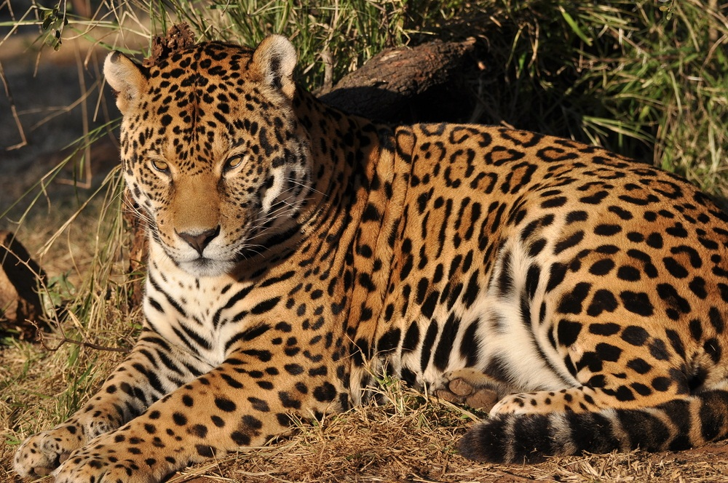

Slide 15
2.) Dry Climate Zones
-Only found in Mexico and South America
-semiarid: generally dry, with some rain
-Grass-covered plains found in this region
-Found in Mexico, Brazil, Uruguay, and Argentina

Slide 16
-desert: found in Northern Mexico as well as Chile (Atacama Desert)
-Also in Southern Argentina (Patagonia)
-Vegetation is mainly shrubs growing in gravel or sand

Slide 17
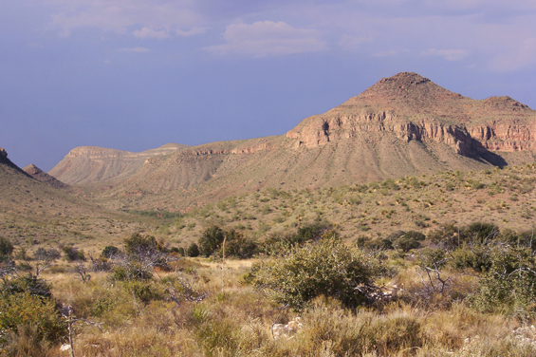
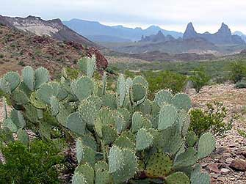

Slide 18
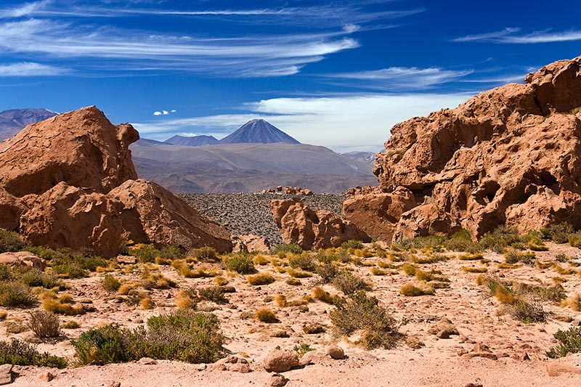

Slide 19
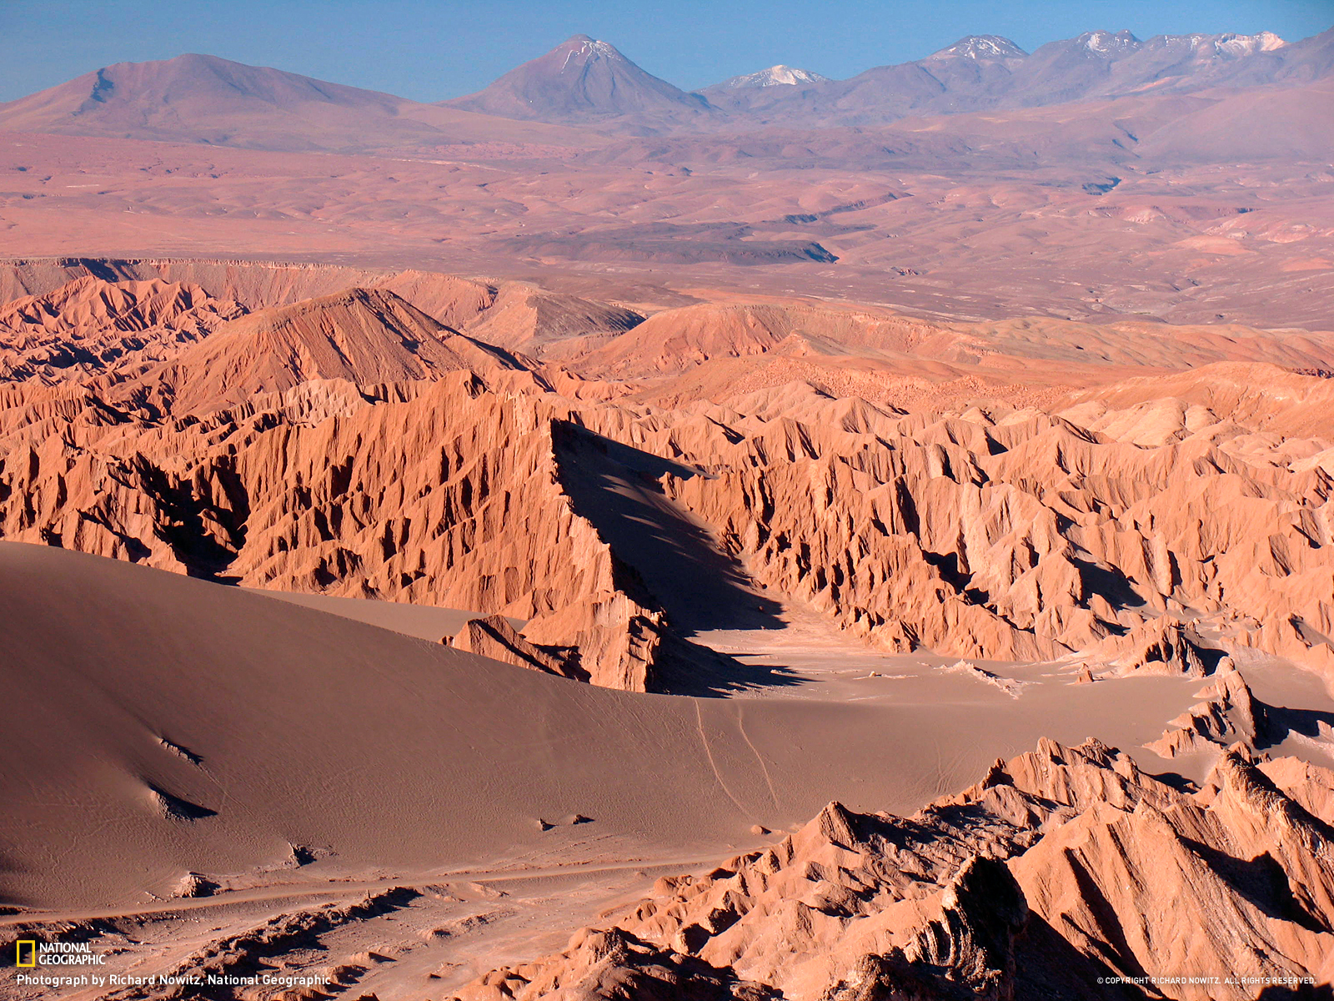

Slide 20
3.) Mid-Latitude Climate Zones
-mediterranean: hot, dry summers and cool, wet winters
-Located along parts of the Western coast of Chile
-similar to weather conditions in some parts of California

Slide 21
-marine west coast: cool, rainy winters and mild, rainy summers
-Found in parts of Southern Chile and Argentina
-Similar to weather conditions in Oregon and Washington in the U.S.

